Slide 1
ANN Hyperparameters
Venkat Reddy

Slide 2
Contents

Slide 3
Contents
Overfitting
L1 and L2 Regularization
Dropout
Activation functions
Learning Rate
SGD
Batch size

Slide 4
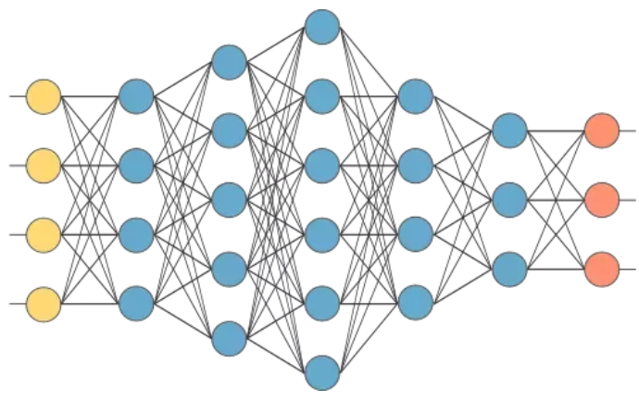
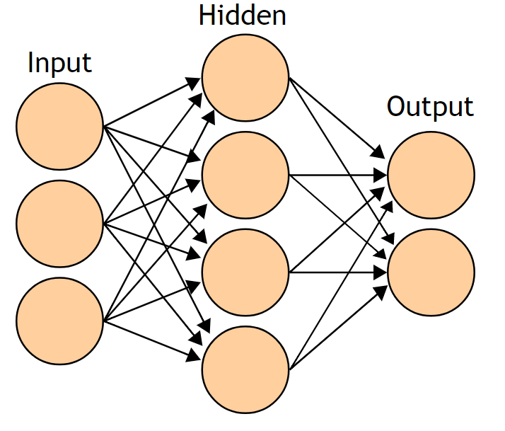
Deep vs Shallow networks
A neural network with single hidden layer is called a shallow network
A neural network with more than one hidden layer is called deep neural network
shallow network
Deep network

Slide 5
Deep vs Shallow networks
A single layer might not have the flexibility to capture all the non linear patterns in the data
A deep network first learns the primitive features followed by high level features. This helps in building efficient models
shallow network
Deep network

Slide 6
Deep neural networks are very powerful
Lot of experiments have shown that a deep network with less parameters performs better than a shallow network with higher parameters
For example deep network with hidden nodes [10,10,10,10] might perform better than shallow network with [180] hidden nodes
Deep neural networks are amazingly powerful.
With sufficient number of hidden layers and nodes, we can fit a model to any type of data
They have the power to capture any amount of non linearity

Slide 7
Deep neural networks - Hyper parameters
There are so many parameters while training
There are some hyper parameters that we need to set at the start of the training. For eg: number of hidden layers and nodes, learning rate of weights
There are many such hyper parameters, if we don’t set them right while building the model you may end up building
An overfitted model
An under fitted model
Or even a never ending(non-converging) model
Model with vanishing gradients
Deep learning expert need to know what are the hyper parameters and how to finetune them
“With great power comes great responsibility”

Slide 8
Regularization

Slide 9
The problem of Overfitting
Neural networks are very powerful. They have capacity to learn any type of pattern.
With high number of hidden layers, we can fit to training data with any level of non-linearity
Too many hidden layers might be fitting the model for random pattern or noise in the data
Throughout the neural network algorithm we were trying optimise weights to make the error zero. This might lead to overfitting
What is overfitting in general? Having too many polynomial terms in a regression line might result in a overfitted model.

Slide 10
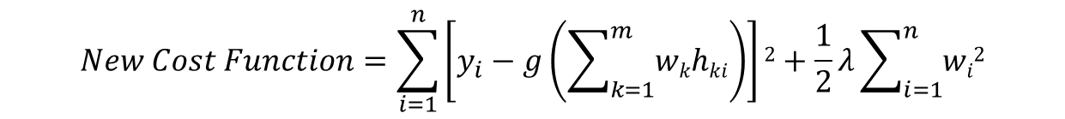
Reduce Overfitting
We have two options to reduce overfitting
Build a simple model. Drop hidden layers and nodes– But this might lead to underfitting
Or hidden layers and nodes but give them less weightage. This will take care of overfitting
Instead of minimising error alone, minimise both error and weights
The regularization term Imposes some penalty on weights. It impacts the overall weights and reduces the overfitting
$$New Cost Function=\sum_{i=1}^{n}{\left[y_{i}−g\left(\sum_{k=1}^{m}{wkhki}\right)\right]2}+\frac{1}{2}λ\sum_{i=1}^{n}{wi2}$$

Slide 11
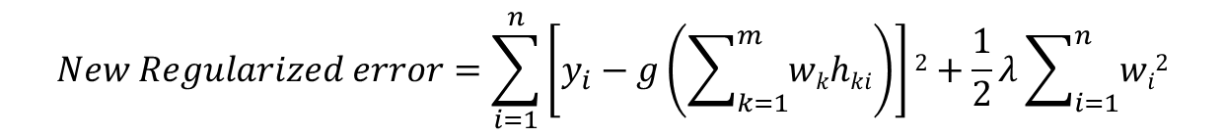
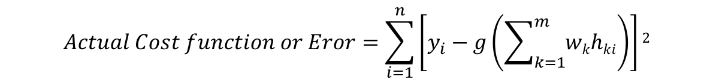
Cost function regularization
$$Actual Cost function or Eror=\sum_{i=1}^{n}{\left[y_{i}−g\left(\sum_{k=1}^{m}{wkhki}\right)\right]2}$$
$$New Regularized error=\sum_{i=1}^{n}{\left[y_{i}−g\left(\sum_{k=1}^{m}{wkhki}\right)\right]2}+\frac{1}{2}λ\sum_{i=1}^{n}{wi2}$$
Apart from minimising error sum of squares, we are minimising error + weights sum of squares also
The second term is imposing a penalty on weights.
This is known as Regularization

Slide 12
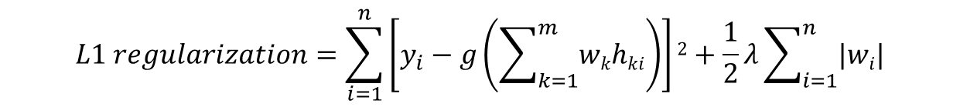
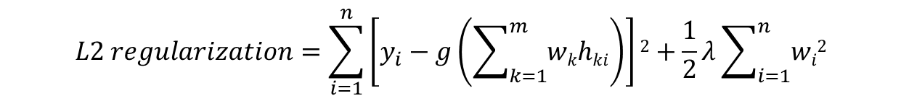
L1 and L2 Regularization
Till now we discussed about minimizing sum of squares of weights. This is known as L2 regularization (Also known as Ridge or Decay)
$$L2 regularization=\sum_{i=1}^{n}{\left[y_{i}−g\left(\sum_{k=1}^{m}{wkhki}\right)\right]2}+\frac{1}{2}λ\sum_{i=1}^{n}{wi2}$$
We can minimize absolute of sum of weights; Which is known as L1 regularization (Also known as LASSO)
$$L1 regularization=\sum_{i=1}^{n}{\left[y_{i}−g\left(\sum_{k=1}^{m}{wkhki}\right)\right]2}+\frac{1}{2}λ\sum_{i=1}^{n}{|wi|}$$
Both of them work equally effectively. Most of the times we choose L2 regularization, for mathematical convenience

Slide 13
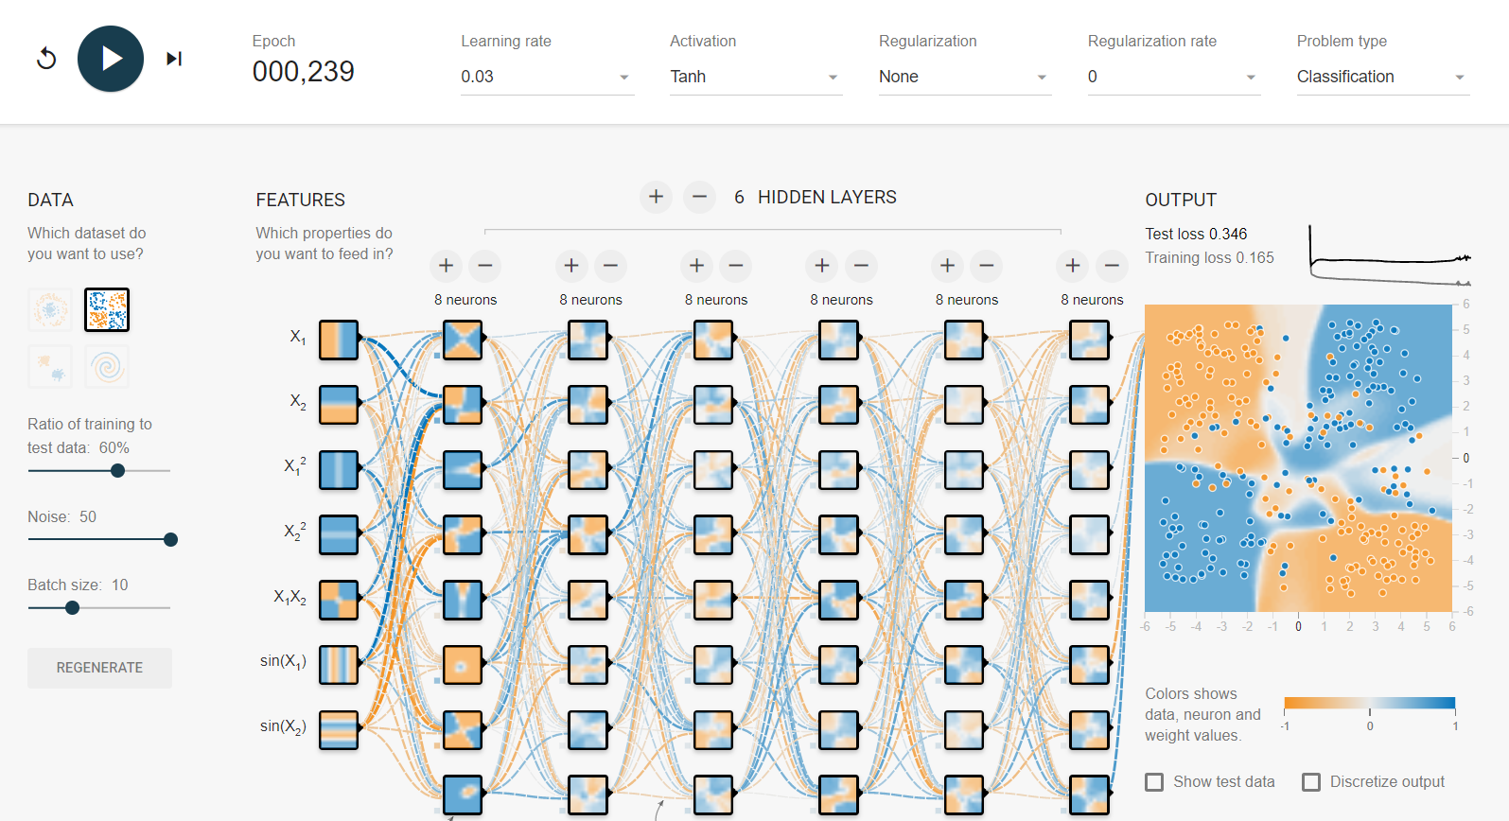
Demo: Regularization
https://playground.tensorflow.org
Lot of hidden layers
No Regularization
Overfitted model

Slide 14
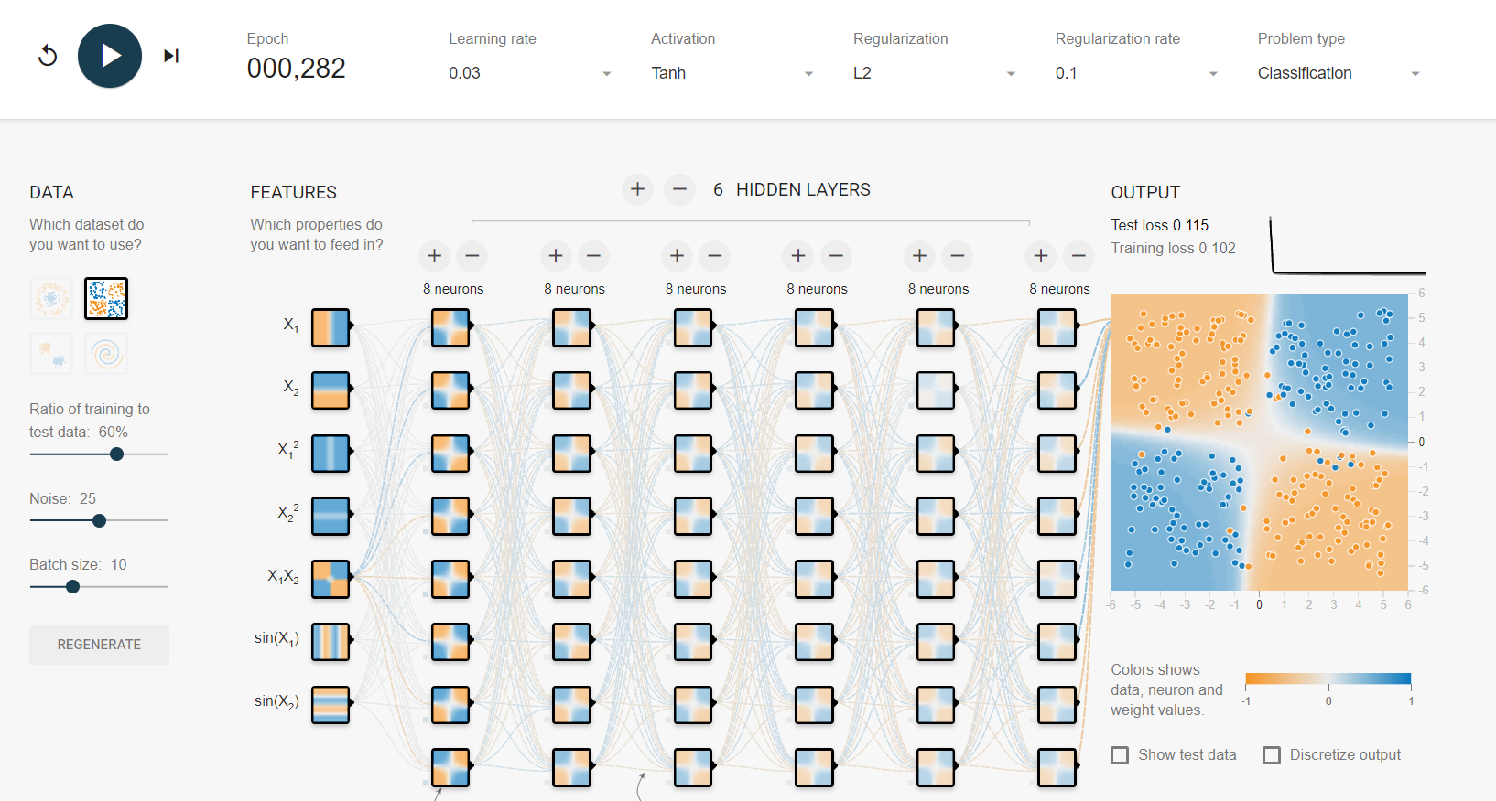
Demo: Regularization
Lot of hidden layers
With Regularization
Model is not overfitted

Slide 15
LAB: L1, L2 Regularization
Try Regularization on MNIST data
Build a model with several hidden nodes and layers. Apply regularization to avoid overfitting

Slide 16
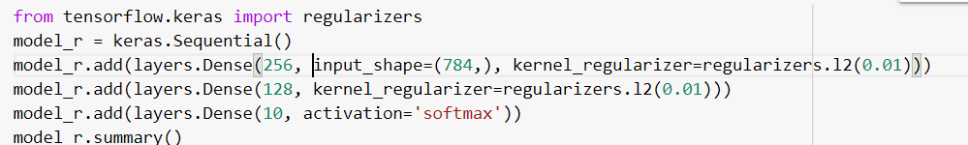
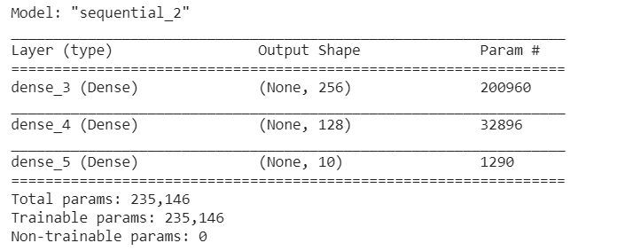
Code: L1, L2 Regularization

Slide 17
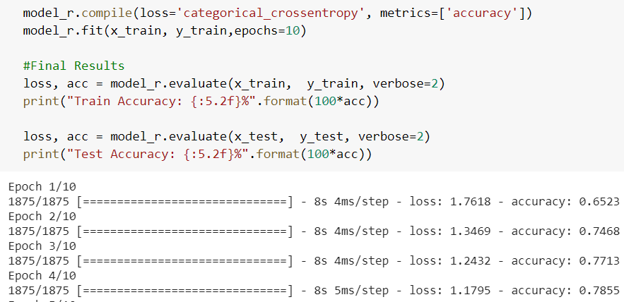
Code: L1, L2 Regularization

Slide 18
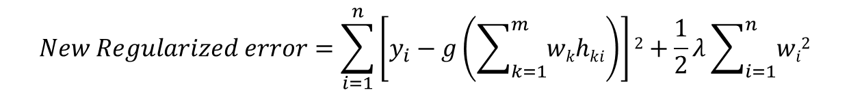
Important Note
We directly work with weights in regularization.
It is important to standardize the data before applying regularization in neural networks
Since a single regularization parameter is applied on all weights, its very important to bring all weights on to same scale
Regularization parameter might not have any impact if the data is not standardised.
$$New Regularized error=\sum_{i=1}^{n}{\left[y_{i}−g\left(\sum_{k=1}^{m}{wkhki}\right)\right]2}+\frac{1}{2}λ\sum_{i=1}^{n}{wi2}$$

Slide 19
Dropout Regularization
The previous method was about penalizing the weight with L1 and L2 regularization
Dropout method is also used for avoiding overfitting
Dropping of the hidden units while building the model
Ignoring few hidden units in each feed forward pass of the back propagation algorithm
‘Dropping out few hidden units in every iteration’
Dropout method forces each neuron to learn a few patterns, it ensures that a single neuron is NOT dominating in the entire model.

Slide 20
How Dropout Regularization works?
Fully connected network
x1
h1
h3
y1
x2
h2
h4
y2
x3

Slide 21
How Dropout Regularization works?
Retain hidden node with probability p
x1
h1
h3
y1
x2
h2
h4
y2
x3

Slide 22
Dropout Regularization
h1 and h3 dropped in iteration1
x1
y1
x2
h2
h4
y2
x3
This is called a thinned network
In each iteration, backpropagation is performed on the thinned network

Slide 23
Dropout Regularization
h1 and h4 dropped in iteration2
x1
h3
y1
x2
h2
y2
x3

Slide 24
Dropout Regularization
h2 and h3 dropped in iteration3
x1
h1
y1
x2
h4
y2
x3

Slide 25
Dropout Regularization
h2 and h4 dropped in iteration4
x1
h1
h3
y1
x2
y2
x3

Slide 26
Final weights in the model(While testing)
At training phase
In each iteration, drop few hidden units and calculate weights
For example each unit is kept with probability 0.5 in each iteration
Train the network and take the final weights matrix from all networks.
At the test time
We use all the weights, as if there was no drop out.
We may have to incorporate dropout impact on weights while perdition
If probability of keeping each node is 0.5 then multiply weights with 0.5
Lets see an example to understand this procedure

Slide 27
Dropout Neural network at training time
We want to train a network with 2 hidden units. i.e we want to find w1 … w6
x1
w1
h1
w2
w5
y
w3
w6
x2
h2
w4
Let 0.5 be the probability of retaining a unit. We will see below structures while training
x1
w1
h1
x1
h1
w2
w5
y
y
x2
h2
w3
w6
x2
h2
w4

Slide 28
Dropout Neural network at training time
At different iterations while training we can write the formula for y as
y=sigmoid(w5*h1) or
y=sigmoid(w6*h2)
Let 0.5 be the probability of retaining a unit. We will see below structures while training
x1
w1
h1
x1
h1
w2
w5
y
y
x2
h2
w3
w6
x2
h2
w4

Slide 29
While testing
While testing take all the weights from final set.
We keep all nodes as if there is no drop out.
The new formula for y is different now
y=sigmoid(w5*h1+ w6*h2)
x1
w1
h1
w2
w5
y
w3
w6
x2
h2
w4
Let 0.5 be the probability of retaining a unit. We will see below structures while training
x1
w1
h1
x1
h1
w2
w5
y
y
x2
h2
w3
w6
x2
h2
w4

Slide 30
Final weights while testing
While training
y=sigmoid(w5*h1) or
y=sigmoid(w6*h2)
While testing
y=sigmoid(w5*h1+ w6*h2)
We may have to incorporate the effect of dropout on weights while testing
h1 and h2 have retaining probability of “p”. They are not picked always. Their weights should not have full impact on y.
Multiply weights by p while testing.
y=sigmoid(p*w5*h1+ p*w6*h2)
y=sigmoid(0.5*w5*h1+ 0.5*w6*h2) (in our example p=0.5)

Slide 31
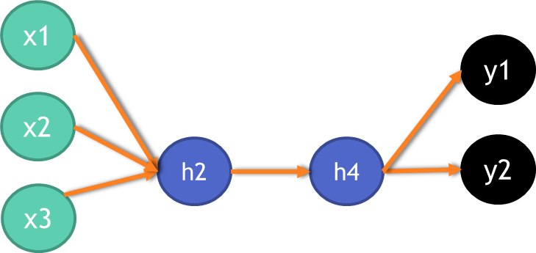
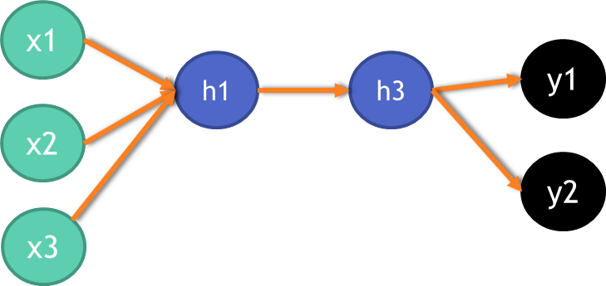
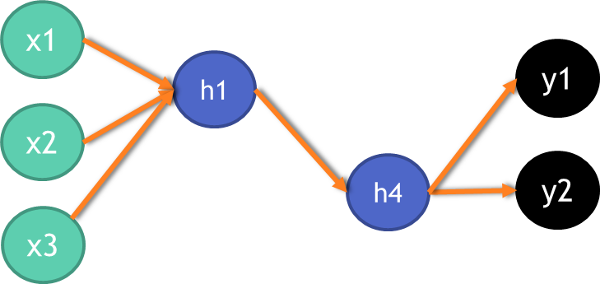
Weights sharing in Dropout
Do not assume that the model is fixed and weights are trained for that network.
The dropout happens at every iteration.
Iteration3 and itertion5 have same network configuration
After completing iteration-4, where do you get the weights for iteration-5?
From iteration3? This is nothing but concept of shared weights.
Iteration-2
Iteration-1
Iteration-5
Iteration-3
Iteration-4

Slide 32
Why Dropout Works?
Avoids Individual Dominance:
Dropout ensures that a single neuron is NOT dominating in the entire model. It may get dropped at any point. Other neurons will get a chance.
Avoids Interdependencies:
If a hidden unit knows that all other hidden units are present, it can co-adapt to them for a given training data.
Since any neuron can be dropped at any iteration, every neuron has to act independently.
No Redundant hidden units anymore
If a hidden unit has to work well alongside a randomly selected group of hidden units, it has to do something that is individually valuable.

Slide 33
LAB: Dropout Regularization
Try Dropout regularization on MNIST data
Build a model with several hidden nodes and layers. Apply dropout to avoid overfitting

Slide 34
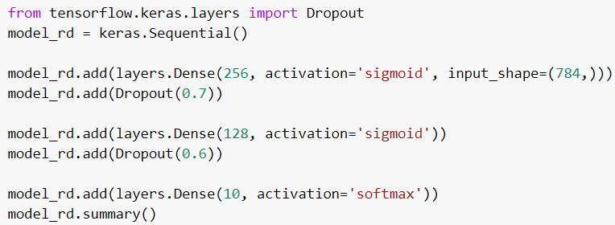
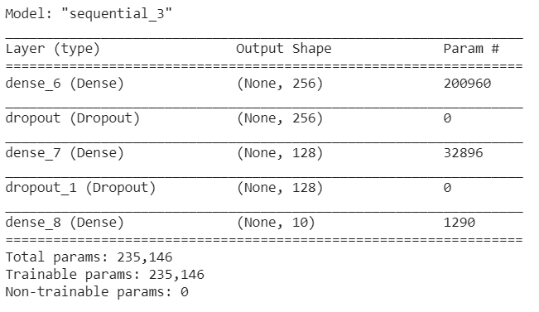
Code: Dropout Regularization

Slide 35
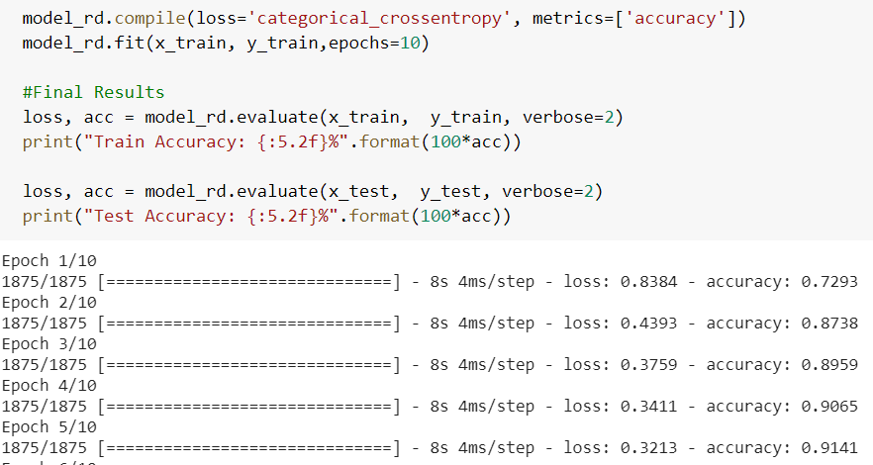
Code: Dropout Regularization

Slide 36
Activation Functions

Slide 37
Activation Functions
1
h1
y
x1
h2
x2
$y=g(\sum{Wjg(\sum{wjkxk})})$
In the above equation g(x) is known as activation function

Slide 38
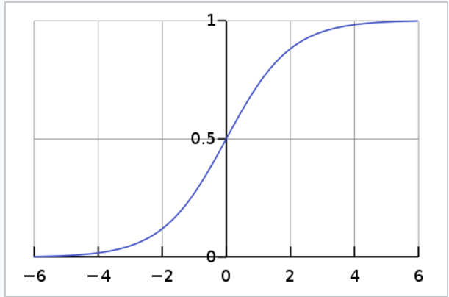
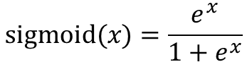
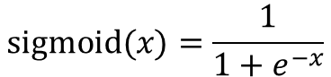
Activation Functions - Sigmoid
Sigmoid function. Historically famous activation function
Also known as Inverse logistic
Works well for usual business related a data
Works well for a binary or multi class output
it takes a real-valued number and “squashes” and outputs number between 0 and 1.
Large negative numbers become 0 and large positive numbers become 1.
$$sigmoid(x)=\frac{e^{x}}{1+e^{x}}$$
$$sigmoid(x)=\frac{1}{1+e^{−x}}$$

Slide 39
Sigmoid- Drawbacks
Sigmoid output not zero centered.
The middle value is 0.5
Most of the times we normalise the data(zero centered) before building the neural network model.
It takes a lot of epochs(time) for convergence
Is there a better activation function for faster convergence?

Slide 40
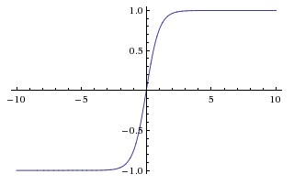
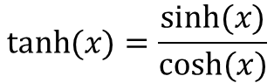
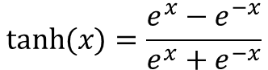
New Activation Function- TanH
The TanH similar to sigmoid
Squashes the real values between -1 and +1
The output is zero centered.
Preferred activation function for zero centered (normalized) data.
$$tanh⁡(x)=\frac{sinh⁡(x)}{cosh⁡(x)}$$
$$tanh⁡(x)=\frac{e^{x}−e^{−x}}{e^{x}+e^{−x}}$$

Slide 41
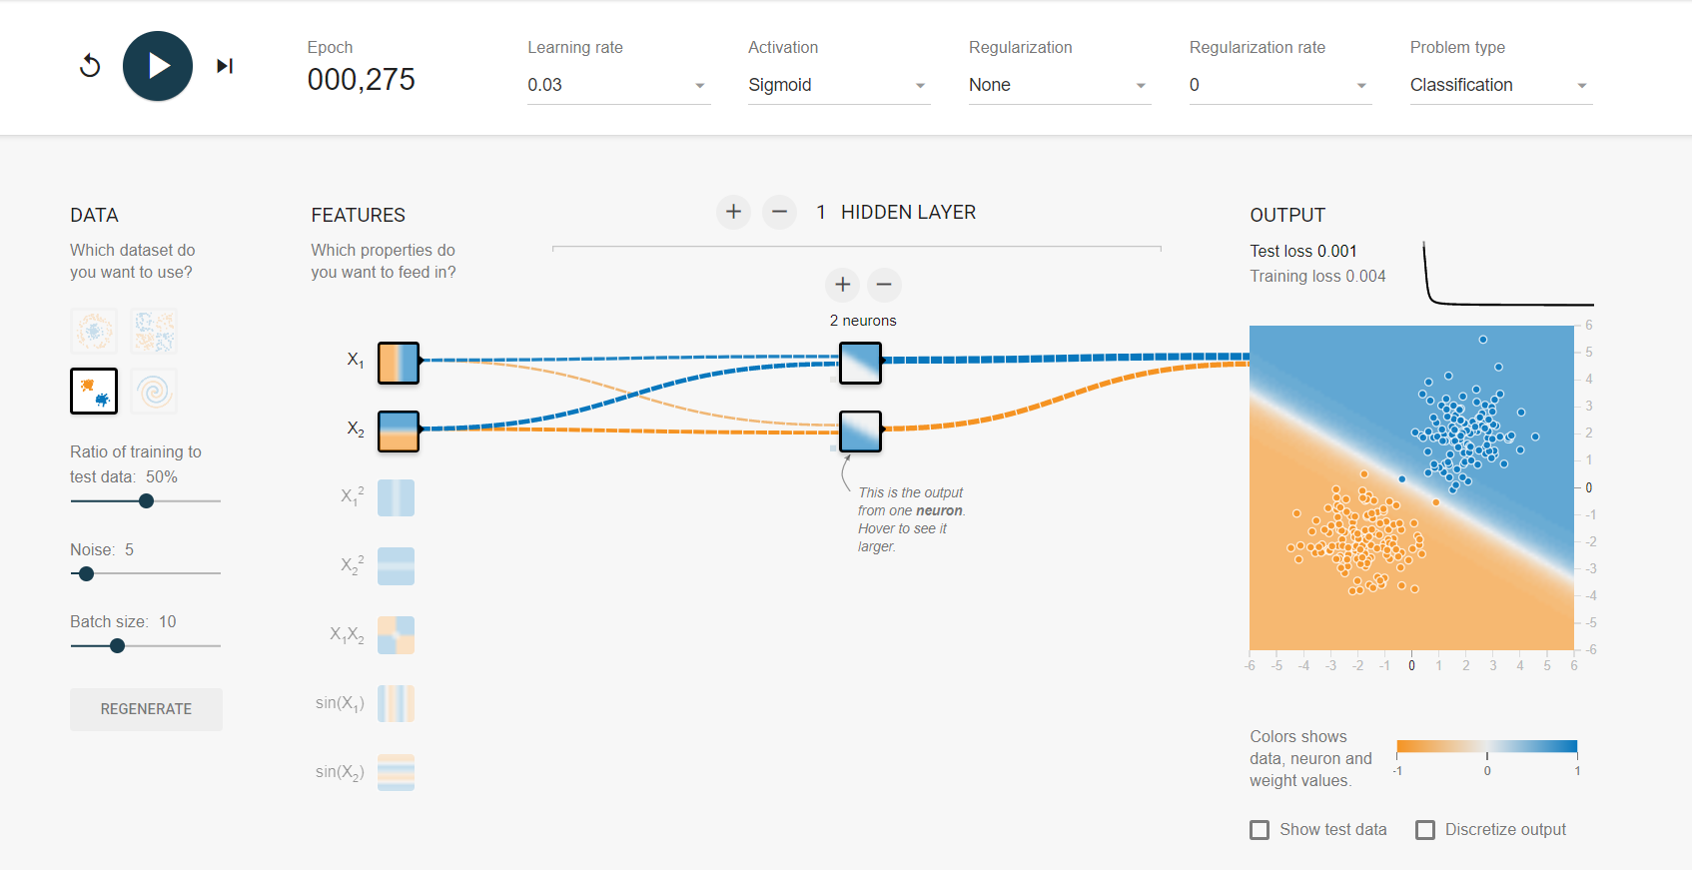
Demo: Sigmoid vs TanH
Sigmoid takes 275 steps

Slide 42
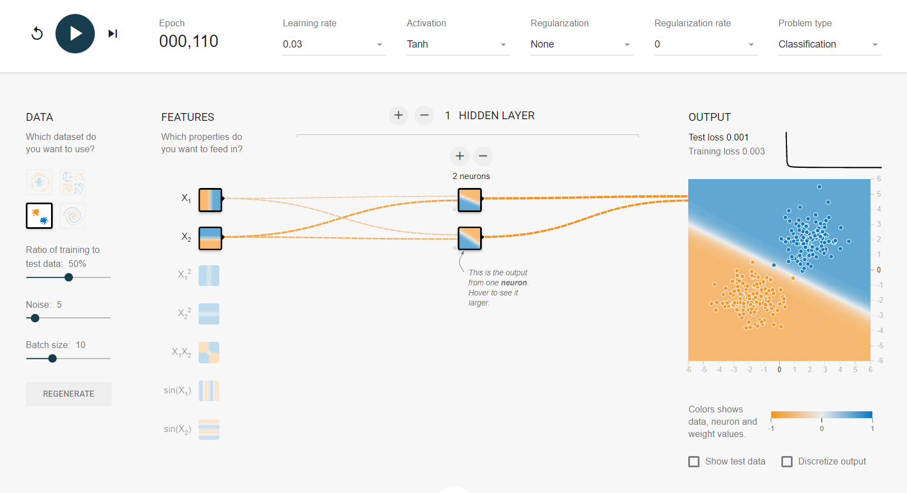
Demo: Sigmoid vs TanH
TahH takes less steps

Slide 43
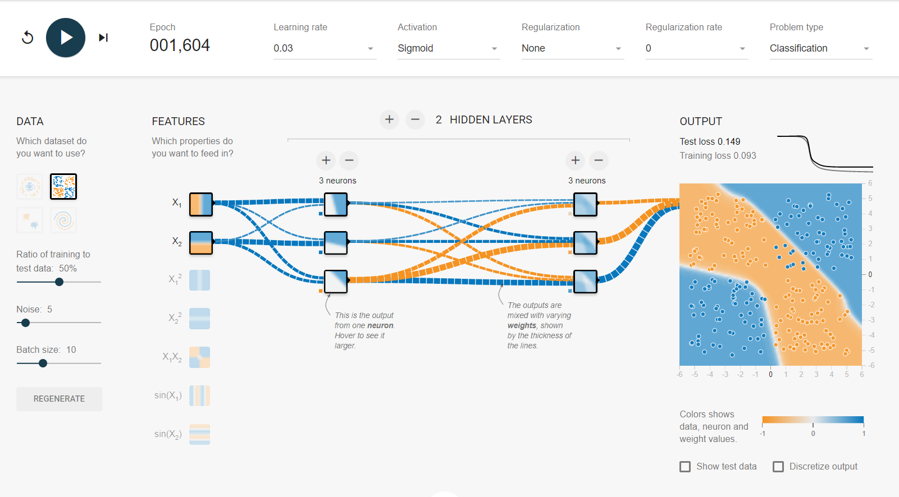
Demo: Sigmoid vs TanH
Sigmoid takes 1,604 steps
Error is still 15%

Slide 44
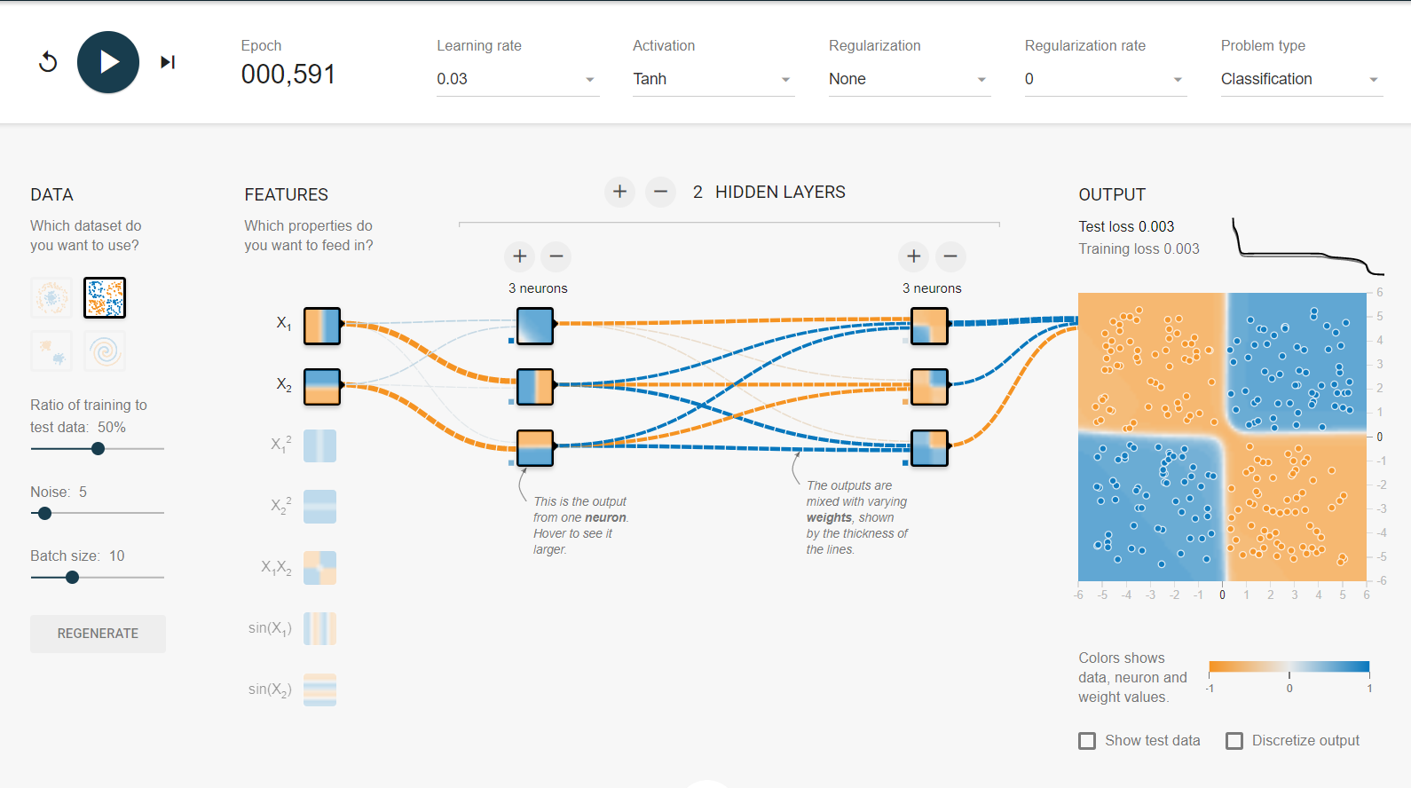
Demo: Sigmoid vs TanH
TanH takes 600 steps
Error is less than %

Slide 45
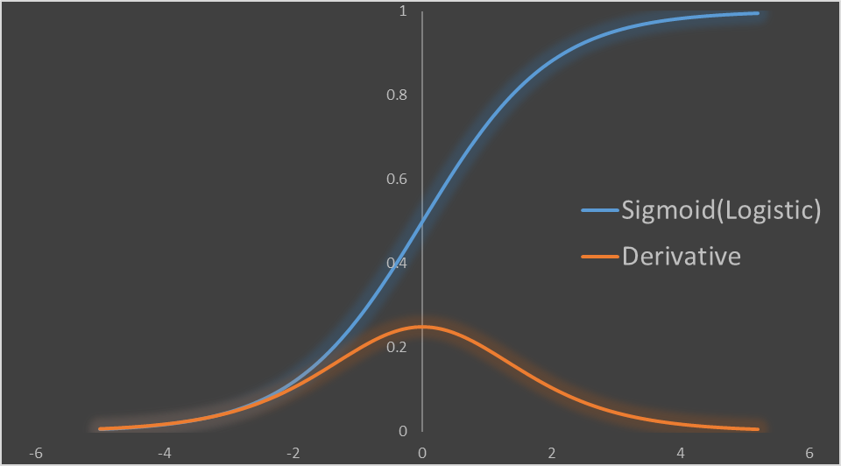
The problem of Vanishing gradients
Your deep neural network might be suffering from a problem of vanishing gradients
Computationally sigmoid values and gradient values and their multiplications are very small
For a deep network with many hidden layers sigmoid gradients vanish very quickly
The derivative of sigmoid is zero on both ends

Slide 46
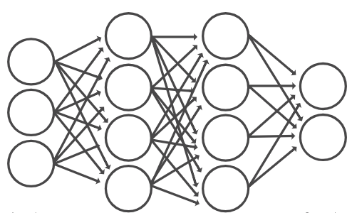
The problem of vanishing gradients
x1
y1
x2
y2
x3
The gradient values are already low here

Slide 47
The problem of vanishing gradients
x1
y1
x2
y2
x3
If the values of gradients at final layers are already low, then gradient will be almost zero for the starting layers
The gradient values are already low here
With small values in the matrix and several matrix multiplications (from layer k to 1) the gradient values shrink exponentially fast. Eventually vanishing completely after a few layers.

Slide 48
Other Observation - Vanishing gradients
x1
y1
x2
y2
x3
Smaller gradients here compared to last layer
Large gradients here compared to first layer

Slide 49
Other Observation - Vanishing gradients
x1
y1
x2
y2
x3
Large gradients here compared to first layer
Learning is faster here
Smaller gradients here compared to last layer
Learning is slower

Slide 50
Other Observation - Vanishing gradients
x1
y1
x2
y2
x3
Smaller gradients here compared to last layer
Learning is slower
No movement in the weights
Large gradients here compared to first layer
Learning is faster here
Converged quickly

Slide 51
Other Observation - Vanishing gradients
x1
y1
x2
y2
x3
Not just sigmoid, tanh also suffers from vanishing gradients problem
We need a new activation function that has larger gradients
We need an activation function that can penetrate from final layer till the first layer
Is there an activation function to handle vanishing gradients problem.

Slide 52
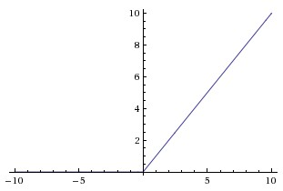
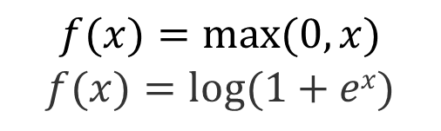
ReLU - The Rectified Linear Unit
$$f(x)=max⁡(0,x)$$
$$f(x)=log⁡(1+ex)$$
Very popular activation function in recent times
f(x)=max(0,x)
In other words, the activation is simply thresholder at zero
Works very well for a certain class of problems
Doesn’t have vanishing gradient problem. It can be used for modelling real values

Slide 53
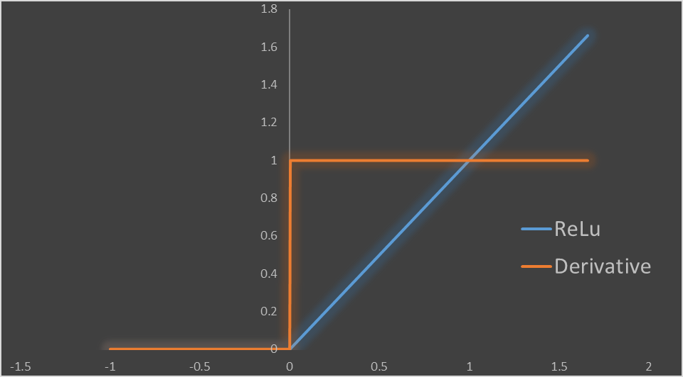
ReLU – Handles Vanishing gradients
The derivative of ReLU is 1 if x>0 else zero
The derivatives are not small fractions
Matrix multiplications won’t result in vanishing gradients

Slide 54
ReLU resolves vanishing gradients issue
x1
y1
x2
y2
x3
The gradients won’t shrink from final layer to previous layers. As we are NOT multiplying them with fractions.
ReLU is used in deep neural networks with too many hidden layers

Slide 55
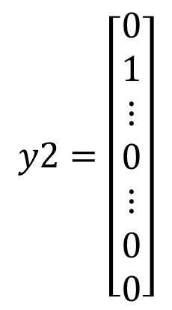
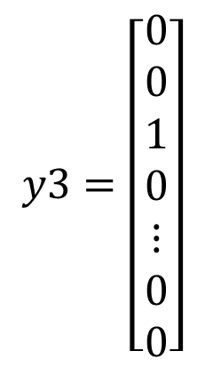
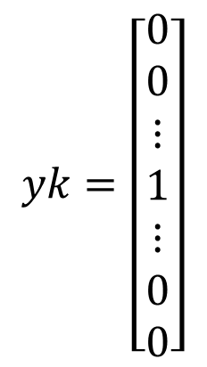
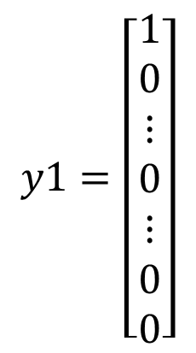
Activation function has last layer
In classification problems ReLU may not be suitable for output layer
ReLU gives the output as 0 or positive continuous number. ReLU output can be 0 or 0.3 or 0.5 or 1.8 or 2 or even 20. In classification, output values are either 1 or 0.
We may need to go back to sigmoid activation for binary output
For multiclass problems the output is 1 for the current class and 0 for rest all classes.
Softmax is used for multiclass output. It is just like sigmoid for multiclass
$$y1=\left[\begin{aligned}1 \\ 0 \\ ⋮ \\ 0 \\ ⋮ \\ 0 \\ 0\end{aligned}\right]$$
$$y2=\left[\begin{aligned}0 \\ 1 \\ ⋮ \\ 0 \\ ⋮ \\ 0 \\ 0\end{aligned}\right]$$
$$y3=\left[\begin{aligned}0 \\ 0 \\ 1 \\ 0 \\ ⋮ \\ 0 \\ 0\end{aligned}\right]$$
$$yk=\left[\begin{aligned}0 \\ 0 \\ ⋮ \\ 1 \\ ⋮ \\ 0 \\ 0\end{aligned}\right]$$

Slide 56
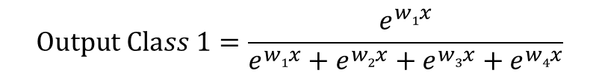
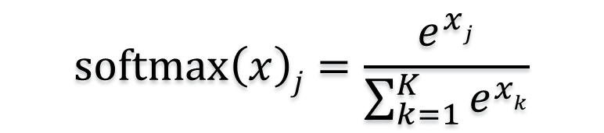
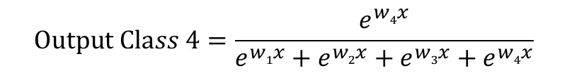
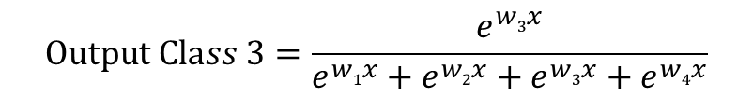
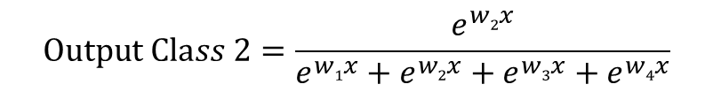
SoftMax for the output layer
SoftMax is just a generalization of sigmoid function for multiclass output
Softmax= Output of class j divided by overall sum of all classes.
$$softmax\left(x\right)j=\frac{e^{xj}}{\sum_{k=1}^{K}{e^{xk}}}$$
Lets take an example output with 4 classes
$$Output Class 1=\frac{e^{w1x}}{e^{w1x}+e^{w2x}+e^{w3x}+e^{w4x}}$$
$$Output Class 2=\frac{e^{w2x}}{e^{w1x}+e^{w2x}+e^{w3x}+e^{w4x}}$$
$$Output Class 3=\frac{e^{w3x}}{e^{w1x}+e^{w2x}+e^{w3x}+e^{w4x}}$$
$$Output Class 4=\frac{e^{w4x}}{e^{w1x}+e^{w2x}+e^{w3x}+e^{w4x}}$$

Slide 57
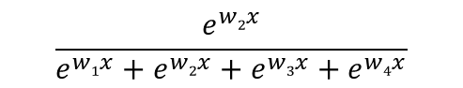
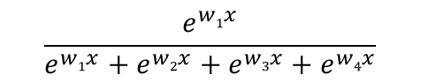
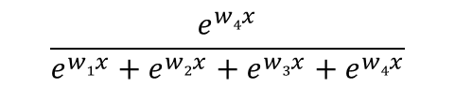
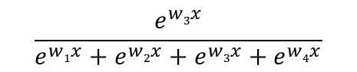
SoftMax for the output layer
You can see SoftMax as summarization of “one vs all” models using sigmoid and scaling it to one.
$$\frac{e^{w1x}}{e^{w1x}+e^{w2x}+e^{w3x}+e^{w4x}}$$
y1
x1
Sum of all outputs is 1
y2
$$\frac{e^{w2x}}{e^{w1x}+e^{w2x}+e^{w3x}+e^{w4x}}$$
x2
y3
$$\frac{e^{w3x}}{e^{w1x}+e^{w2x}+e^{w3x}+e^{w4x}}$$
x3
y4
$$\frac{e^{w4x}}{e^{w1x}+e^{w2x}+e^{w3x}+e^{w4x}}$$

Slide 58
LAB: Activation functions
Try different activation functions on MNIST example

Slide 59
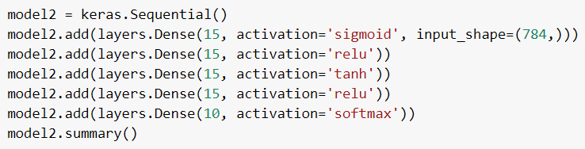
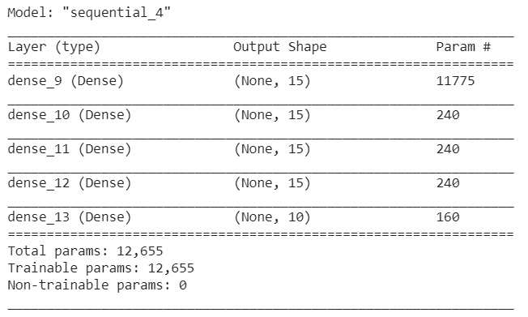
Code: Activation Functions

Slide 60
Learning rate

Slide 61
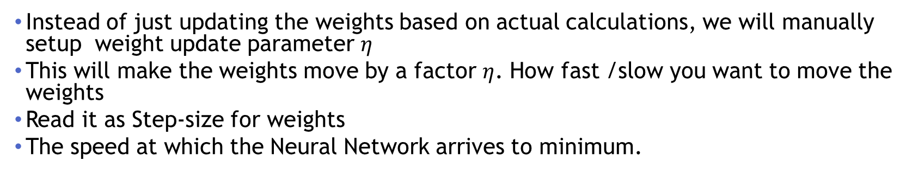

Learning rate
The weight updating in neural networks
$$Wjk :=W_{jk}+∆Wjk$$
$$where ∆Wjk=η.yjδk$$
$$where η \text{is} \text{the} \text{learning} \text{parameter}$$
$$Wjk :=W_{jk}+η.yjδk$$
Instead of just updating the weights based on actual calculations, we will manually setup weight update parameter $η$
This will make the weights move by a factor $η$. How fast /slow you want to move the weights
Read it as Step-size for weights
The speed at which the Neural Network arrives to minimum.

Slide 62
Learning Rate tuning
If the learning rare is too high, the system will either oscillate about the true solution or it will diverge completely.
If the step-size is too low, the system will take a long time to converge on the final solution.
Generally start with a large value, reduce it gradually.
learning rate too high. No change in error function
learning rate too low. Negligible change in error rate, slow training

Slide 63


Learning Rate is Important
For the actual practical problems the error surfaces are very complex
Learning rate is very important to avoid local minima
Small learning rate
Small steps towards minima
Has a risk of ending up in local minima
Optimal learning rate
Avoids local minima
High chance of ending at global minima

Slide 64

Demo: Learning rate
High learning rate
High error
No Improvement in the error

Slide 65

Demo: Learning rate
Very low learning rate
Too many steps
Takes a lot of time to converge

Slide 66

Demo: Learning rate
Optimal learning rate
Low error
Less steps

Slide 67
LAB: Learning Rate
Build a deep NN model with high learning rate. Observe the impact on the target
Build a model with a very low learning rate. Observe the impact
Finetune learning rate and build an optimal model.

Slide 68

Code: Learning Rate

Slide 69

Code: Learning Rate

Slide 70

Code: Learning Rate

Slide 71
SGD (Stochastic Gradient Descent)
The actual gradient descent looks at the whole training data to update the weights. i.e the weights get updated once in every epoch
SGD will change the weights for every sample record. Within an epoch the weights will get changed multiple times.
SGD will do several iterations within an epoch of standard gradient decent

Slide 72
Mini-batch Gradient Descent
GD updates weights over full training data
SGD updates weights for every point
Although SGD works, but in practise we don’t want to update weights for every training sample.
A single record used for updating weights will cause high variance in weights.
May be it’s a good idea to send batches of training samples to calculate the gradient
We have more confidence while updating the weights based on a small subset of training rather than updating based on single sample

Slide 73
Mini-batch Gradient Descent
Split the training dataset into small batches calculate the error, update the weights
Most commonly used implementation of gradient descent
Much faster than gradient descent and SGD
This comes with another hyper parameter “batch size”
Do not choose a very low number or really high number. The optimal batch sizes depends on your data.

Slide 74
LAB: GD, SGD and Mini-batch GD
Data set : MNIST
Model-1: Build a model using standard SGD - take a note of time taken and accuracy
Model-2 : minibatch batch size 128- take a note of time taken and accuracy

Slide 75
Loss Functions

Slide 76

Loss Functions
$$Squared loss (E)$$ | $$\frac{1}{2}\sum{{\left(y−\hat{y}\right)}^{2},}$$
Mean squared error (MSE) | $$\frac{1}{n}\sum{{\left(y−\hat{y}\right)}^{2}}$$
Mean absolute error (MAE) | $$\frac{1}{n}\sum{|y−\hat{y}|}$$
Mean absolute percentage error (MAPE) | $$\frac{1}{n}\sum{\frac{|y−\hat{y}|}{y}}$$
Deviation based loss functions work best for regression problems.

Slide 77


Cross Entropy
$$Binary cross entropy=−\sum{\left(\left.ylog\left(\hat{y}\right)+(1−y)log(1−\hat{y}\right)\right)}$$
Actual Value $$(y)$$ | Predicted Value $$\left(\hat{y}\right)$$ | Cross-Entropy Formula | Loss (Log base-10) | Loss (Log base-e)
0 | 0.01 | –($\left(0)log\left(0.01\right)+(1)log(0.99)\right)$ | 0.004 | 0.01
0 | 0.99 | –($\left(0)log\left(0.99\right)+(1)log(0.01)\right)$ | 2 | 4.605
1 | 0.01 | –($\left(1)log\left(0.01\right)+(0)log(0.99)\right)$ | 2 | 4.605
1 | 0.99 | –($\left(1)log\left(0.99\right)+(0)log(0.01)\right)$ | 0.004 | 0.01

Slide 78

Cross Entropy
$$Cross−entropy for three classes=−\sum{\left(y_{1 }log\left(\hat{y_{1 }}\right)+y_{2}log\left(\hat{y_{2 }}\right)+y_{3 }log\left(\hat{y_{3 }}\right)\right)}$$
$$Categorical cross−entropy=\sum_{j=1}^{m}{y_{j }log\left(\hat{y_{j }}\right)where j=1 to m classes\text{. }}$$
model.compile(loss='categorical_crossentropy', metrics=['accuracy'])
Cross entropy based loss functions work best for classification problems.

Slide 79
Conclusion
We discussed regularization, activation functions, learning rate and optimization functions
These hyperparameters finetuning decides the accuracy and efficiency of the model

Slide 80
Thank you

